Slide 1
“It is not enough to simply teach pupils to read; we have to give them something worth reading. Something that will stretch their imaginations. Something that will help them make sense of their own lives and encourage them to reach out toward people whose lives are quite different from their own.”
– Katherine Paterson

Slide 2

Reading in EYFS- Parent workshop
25.9.25

Slide 3
What we will cover today:
The importance of reading
How we teach reading at Whitecote
What phonics is
How to support with reading at home

Slide 4
The importance of reading
Reading is a vital skill that underpins all areas of learning. It enables children to develop a rich vocabulary, deepens their understanding of language and the wider world, and fosters critical thinking.
Establishing strong reading habits from an early age not only supports academic success but also nurtures a lifelong love of literature.
We are about “creating readers, not just pupils who read”
(Reading Framework 2023)

Slide 5
The EYFS framework states that children need to develop:
A strong foundation in language comprehension—understanding and processing language through rich spoken and read-aloud experiences.
The ability to decode words and recognise familiar words swiftly—skills taught through systematic phonics.

Slide 6
Along side this children need to also develop
pleasure in reading;
motivation to read;
increased vocabulary;
improved level of understanding.
They will do this by frequently listening to:
stories;
poems;
information texts;
texts that they cannot yet read for themselves.
By reading with an adult, children can also be shown the processes of finding information within a book, such as the use of contents or index pages. “creating readers, not just pupils who read”. (Reading Framework 2023).

Slide 7

To meet the GLD for comprehension
Demonstrate understanding of what has been read to them by retelling stories and narratives using their own words and recently introduced vocabulary
Anticipate – where appropriate – key events in stories
Use and understand recently introduced vocabulary during discussions about stories, non-fiction, rhymes and poems and through role play

Slide 8
To meet the GLD for word reading
Say a sound for each letter of the alphabet and at least 10 diagraphs
Read words consistent with their phonic knowledge by sound-blending.
Read aloud simple sentences and books that are consistent with their phonic knowledge, including some common exception words.
We teach phonics on a daily basis and children focus on developing their understanding of a wide range of sounds

Slide 9
How we teach reading at Whitecote
Decoding (word reading – phonics)
Comprehension (understanding the words)
Fluency (reading accurately, quickly, with expression)
Reading for pleasure
These run alongside each other from the beginning.
They are underpinned by talk within a language rich environment.

Slide 10
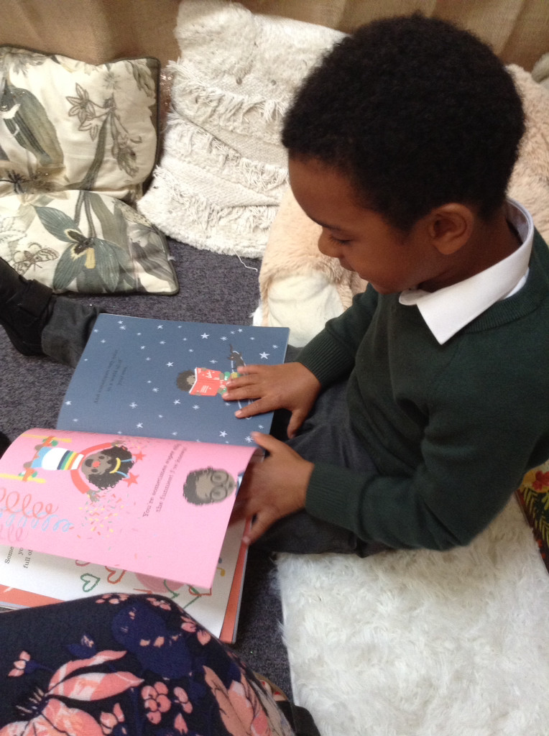
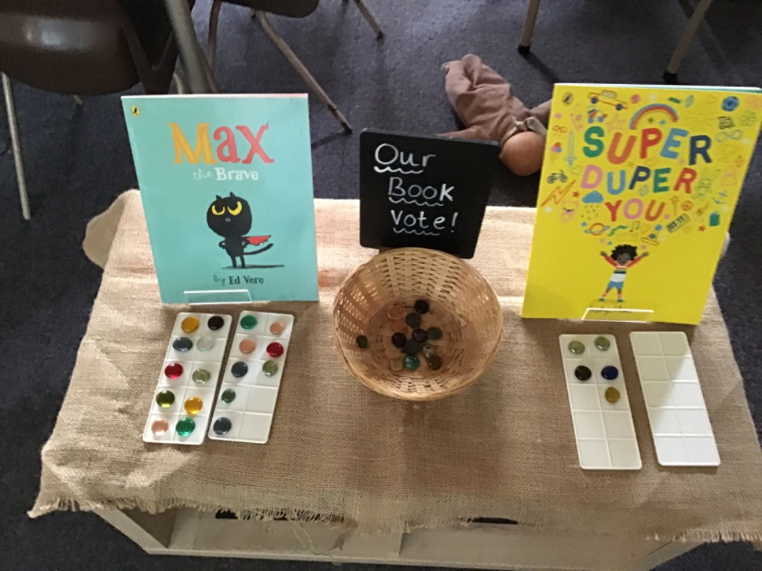
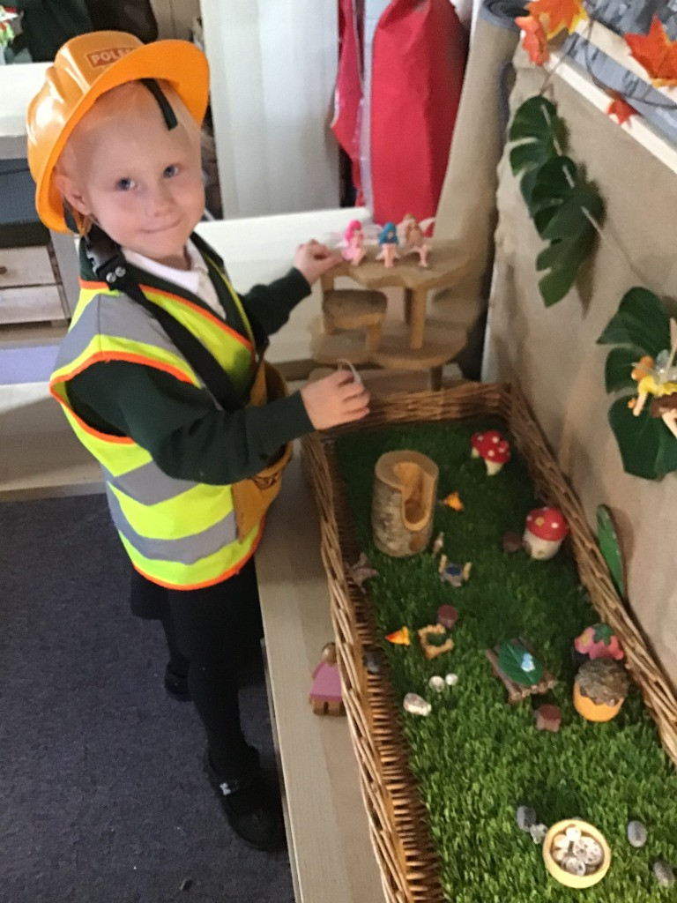
A language-rich environment
Interactions with highly trained staff
Back-and-forth talk
Inviting classroom book corners
Daily Storytime and Rhymes
Carefully selected, high quality books (non-fiction & stories)
Play experiences that encourage children to revisit ideas and vocab
Lots of opportunities to read and write and to act out familiar stories in their chosen play

Slide 11
What is Phonics?
Phonics is a method of teaching reading and writing that focuses on the relationship between letters (graphemes) and the sounds (phonemes) they represent, helping learners decode words by “sounding them out.”
Children begin to learn phonics (sounds/codes) in Early Years both in Nursery and Reception. Once children begin learning sounds, these sounds are used orally to identify and make words. They will then begin to learn the letters which make each of the sounds and these are used to read and spell words.
For this reason, the first initial sounds that are taught are ‘s’, ‘a’, ‘t’, ‘p’, ‘i’, ‘n’. These can immediately be blended for reading to make simple CVC words (consonant, vowel, consonant) e.g. sat, pin. Children then develop segmenting for writing skills; breaking the word into sounds to spell it out.

Slide 12
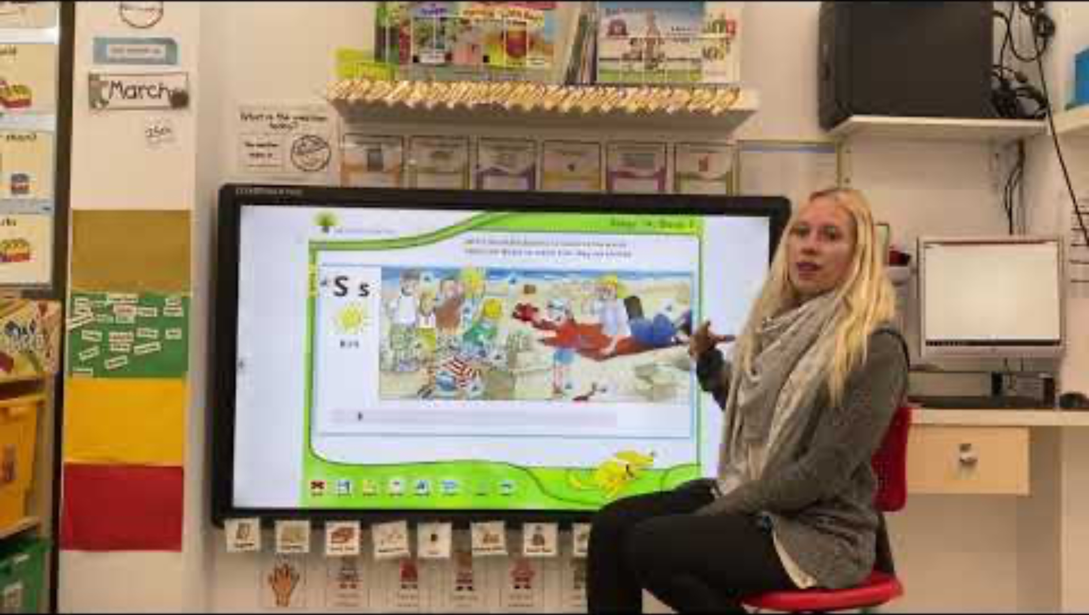
Demonstration lesson:
Introducing a new piece of code

Slide 13
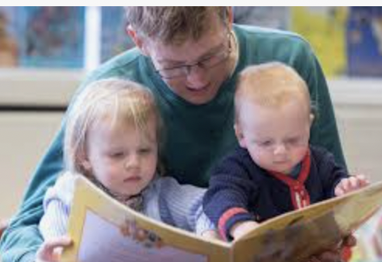
Reading Every Day
Reading to your child every day is just as important as
hearing your child read to you.
Reading to your child will help your child to develop their understanding of what they hear. It can also inspire them to want to read for themselves.
Try to read to your child at a higher level than they can read by themselves.
Remember to talk about new words you come across together.
Complete the home reading record each time your child reads at home for them to receive a home reading sticker.

Slide 14




Reading for Understanding
What is happening? Talk about what is happening in the
pictures before you read the text. What can you see?
Discuss the setting of the story. Have you read another book
with the same setting?
Start in the middle of a book. What do you think has happened
before this point? What makes you think that?
Use a dictionary together to get your child used to
exploring words for themselves.

Slide 15
And finally…..
Each child is on their own reading journey!
Try not to compare with friends or siblings.
We will give targeted support in school if their progress is not at the level typical for their age or if their progress has stalled.

Slide 16

Over to You

Slide 17
Resource pack
20 things to do before reading
Parent hand out
Recommended reading list
Phonics sound mat
Set 1 of helpful words

